Slide 1

Apache Airflow
Notes:
https://courses.cs.washington.edu/courses/cse403/13au/lectures/git.ppt.pdf
http://enos.itcollege.ee/~jpoial/allalaadimised/git/getting-started-with-git.pdf

Slide 2
A typical workflow

Slide 3
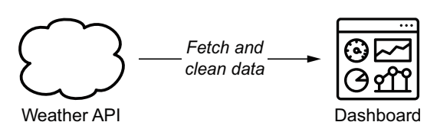
Data pipelines
Consist of several tasks
To achieve the desired result
Overview of the weather dashboard use case, in which weather data is fetched from an external API and fed into a dynamic dashboard
Notes:
Why manage configurations?
Keeps you from making small or large changes that go undocumented
These misconfigurations can lead to poor performance, inconsistencies, or noncompliance and negatively impact business operations and security.
When undocumented changes are made across many systems and applications, it adds to instability and downtime.

Slide 4
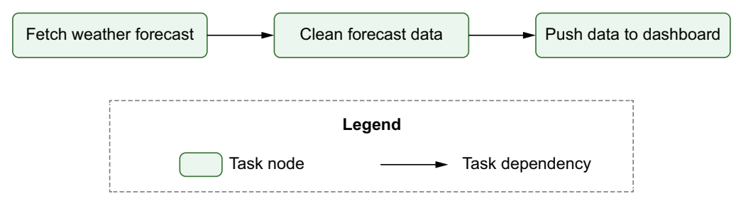
Data pipelines as graphs
Graph representation of the data pipeline for the weather dashboard.

Slide 5
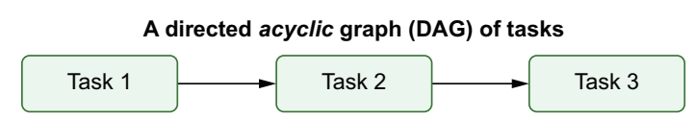
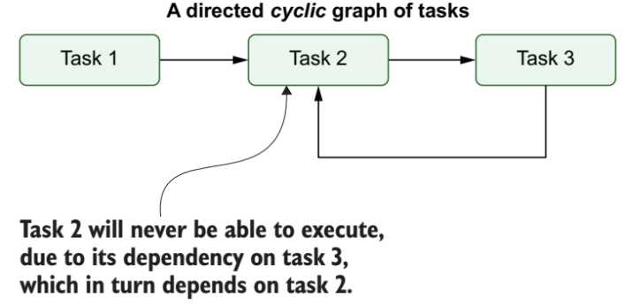
DAG

Slide 6
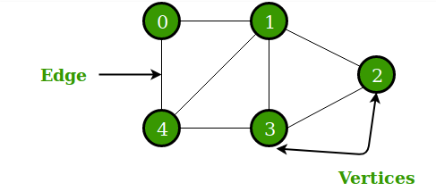
DAG

Slide 7
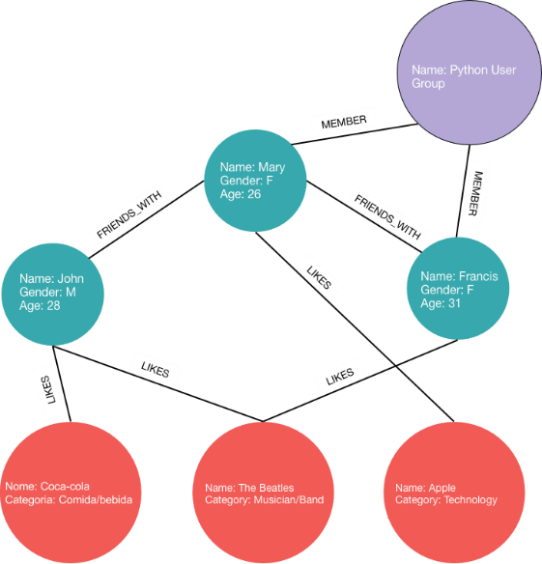
DAG

Slide 8
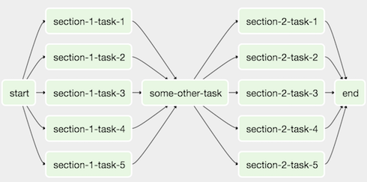
Airflow DAG

Slide 9
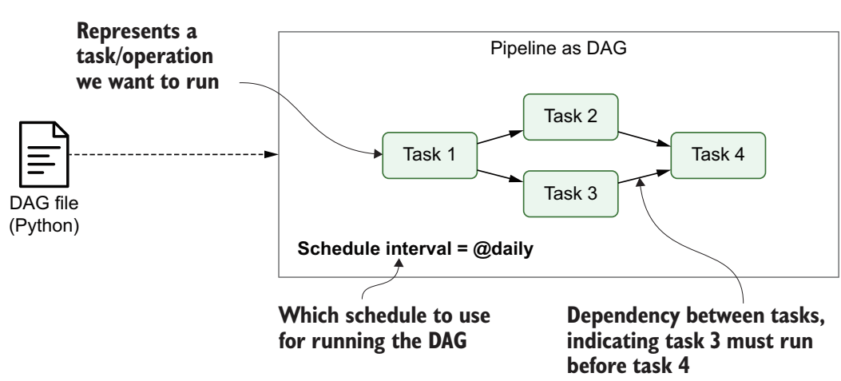
Airflow
An open source solution for developing and monitoring workflows
Pipelines are defined as DAGs using Python code in DAG files
Each DAG file typically defines one DAG, which describes the different tasks and their dependencies
Also defines a schedule interval

Slide 10
Why Airflow?
Can handle upstream/downstream dependencies gracefully
Easy to reprocess historical jobs
Handle errors and failures gracefully
Automatically retry when a task fails
Ease of deployment of workflow changes (continuous integration)
Integrations with a lot of infrastructure
Hive, Presto, Druid, AWS, Google cloud, etc
Data sensors to trigger a DAG when data arrives
Job testing through airflow itself
Accessibility of log files and other meta-data through the web GUI
Monitoring all jobs status in real time + Email alerts
Community support

Slide 11
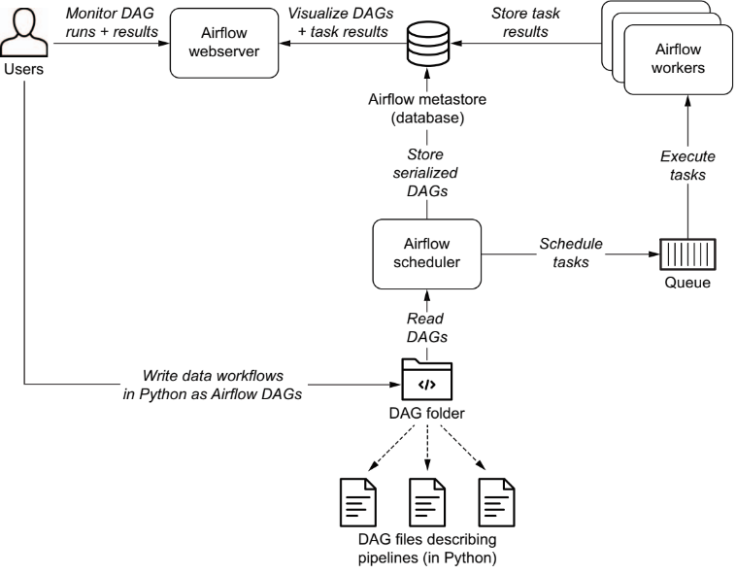
Overview of the main components

Slide 12
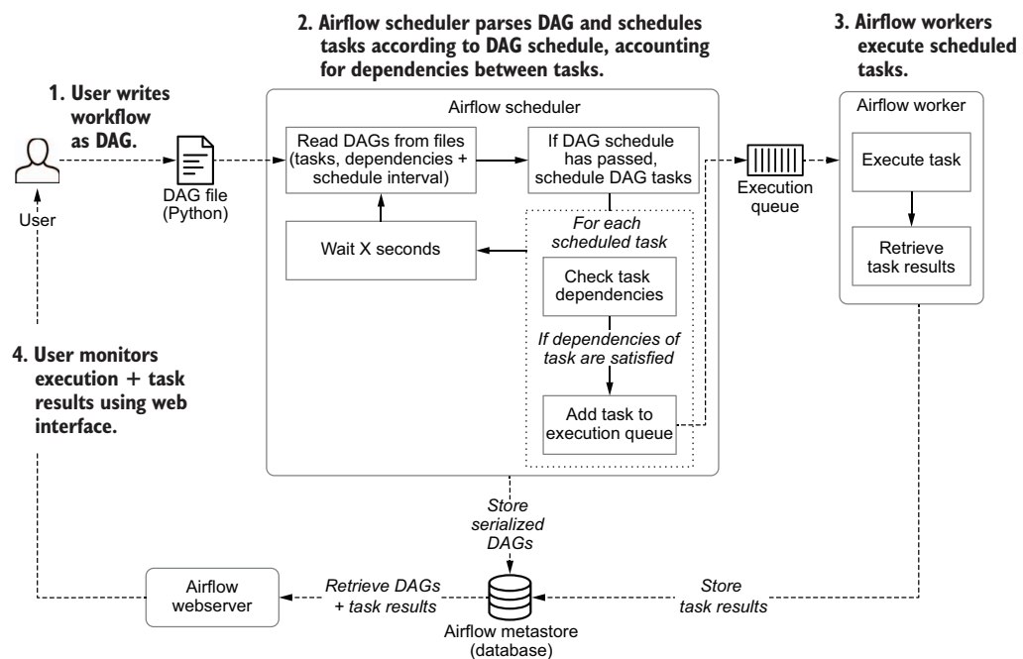
Process involved to develop & execute pipelines

Slide 13
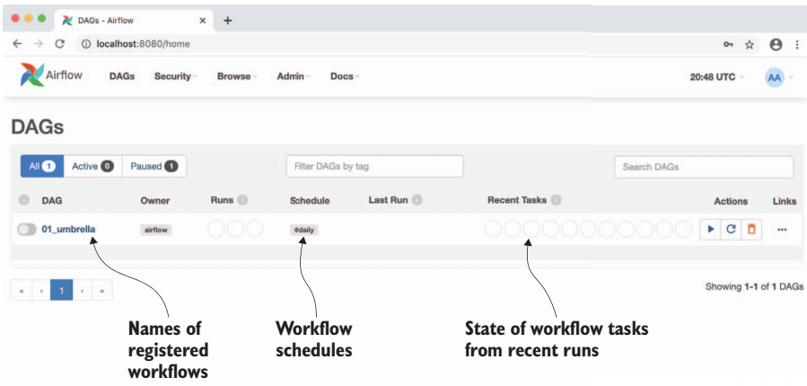
Web Interface of Airflow UI
The main page of Airflow’s web interface, showing an overview of the available DAGs and their recent results

Slide 14
Airflow applications
Data warehousing
Machine Learning
Email targeting
Data infrastructure maintenance

Slide 15
Airflow Concepts

Slide 16
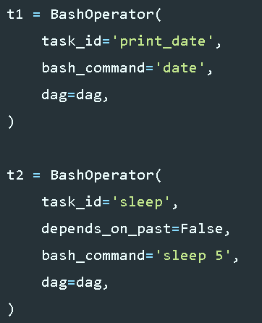
Operators, and Tasks
DAGs do not perform any actual computation
Instead, Operators determine what actually gets done
Task
Once an operator is instantiated, it is referred to as a “task”
An operator describes a single task in a workflow.
A DAG is a container that is used to organize tasks

Slide 17
Operators categories
Sensors
Will keep running until a certain criteria is met
Example include waiting for a certain time, external file, or upstream data source.
Operators
Triggers a certain action
e.g. run a bash command, execute a python function, or execute a Hive query, etc
Transfers
Moves data from one location to another
MySqlToHiveTransfer: Moves data from MySql to Hive.
S3ToRedshiftTransfer: load files from s3 to Redshift

Slide 18
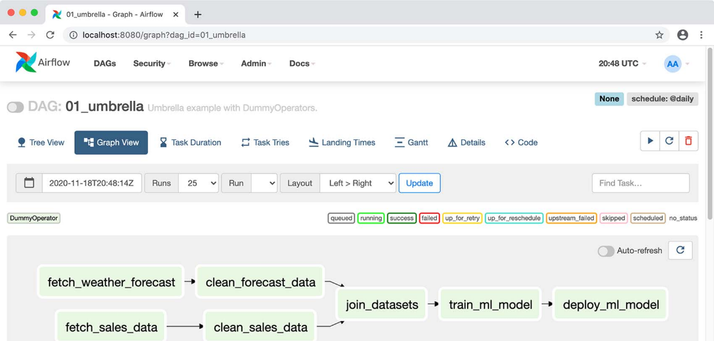
Airflow Tasks
Overview of the tasks in an individual DAG and the dependencies between these tasks

Slide 19
Write an Airflow DAG

Slide 20
Steps to write an Airflow DAG
Step 1: Importing modules
Step 2: Default Arguments
Step 3: Instantiate a DAG
Step 4: Tasks
Step 5: Setting up Dependencies

Slide 21
Step 1: Importing modules
from datetime import timedelta
import airflow
from airflow import DAG
from airflow.operators.bash_operator import BashOperator

Slide 22
Step 2: Default Arguments
default_args = {
'owner': 'airflow',
'start_date': airflow.utils.dates.days_ago(2),
'depends_on_past': False,
'email': ['airflow@example.com'],
'email_on_failure': False,
'email_on_retry': False,
# If a task fails, retry it once after waiting at least 5 minutes
'retries': 1,
'retry_delay': timedelta(minutes=5),
}

Slide 23
Step 3: Instantiate a DAG
dag = DAG(
‘dag-sample',
default_args=default_args,
description='A simple tutorial DAG',
# Continue to run DAG once per day
schedule_interval=timedelta(days=1),
)

Slide 24
Step 4: Tasks
# t1, t2 and t3 are examples of tasks created by instantiating operators
t1 = BashOperator(task_id='print_date’, bash_command='date’, dag=dag,)
t2 = BashOperator(task_id='sleep’, depends_on_past=False, bash_command='sleep 5', dag=dag,)
templated_command = """
{% for i in range(5) %}
echo "{{ ds }}"
echo "{{ macros.ds_add(ds, 7)}}"
echo "{{ params.my_param }}"
{% endfor %}
"""
t3 = BashOperator(task_id='templated', depends_on_past=False, bash_command=templated_command, params={'my_param': 'Parameter I passed in'}, dag=dag,)

Slide 25
Step 5: Setting up Dependencies
# t2 will depend on t1
t1.set_downstream(t2)
# t3 will depend on t1
t3.set_upstream(t1)
t1 >> t2
t2 << t1
t1.set_downstream([t2, t3])
t1 >> [t2, t3]
[t2, t3] << t1

Slide 26
DagRuns
execution_time
Begin at the DAG’s start_date and repeat every schedule_interval.
For each execution_time, a DagRun is created and operates under the context of that execution time
A DagRun is simply a DAG that has a specific execution time.

Slide 27
TaskInstances
The task that belongs to DagRuns

Slide 28
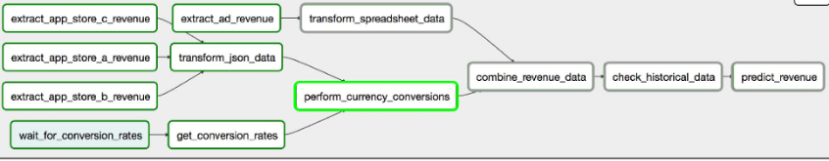
UI DAG Graph View

Slide 29
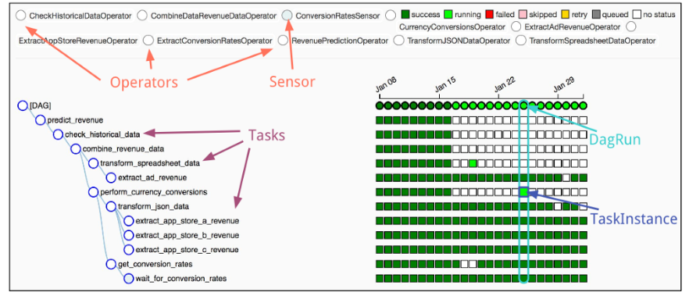
UI DAG Tree View

Slide 30
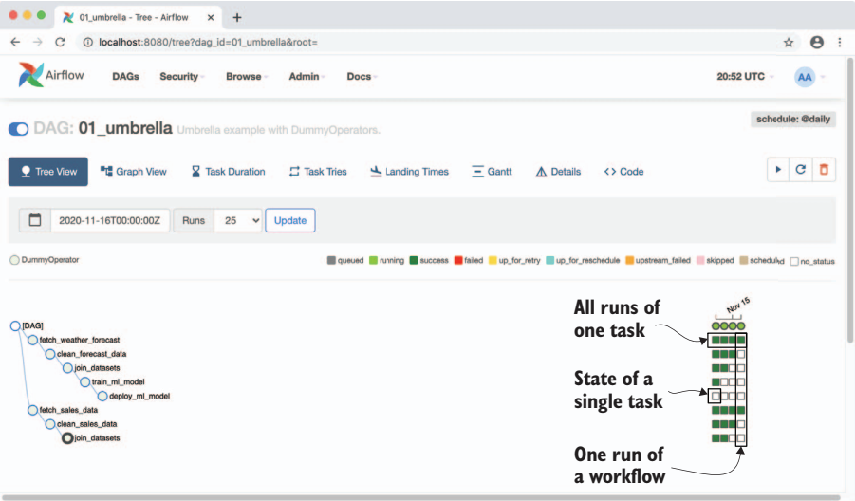
Incremental loading and backfilling

Slide 31
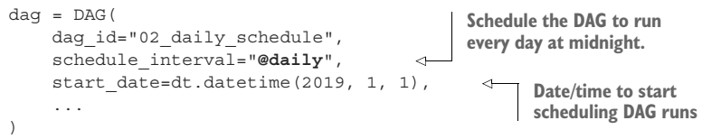
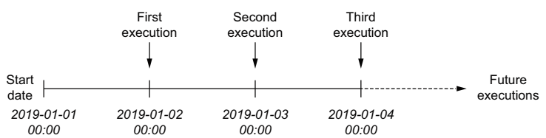
Scheduling intervals
Schedule intervals for a daily scheduled DAG with a specified start date (2019-01-01)
Arrows indicate the time point at which a DAG is executed
Without a specified end date, the DAG will keep being executed every day until the DAG is switched off.

Slide 32
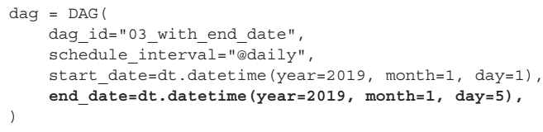
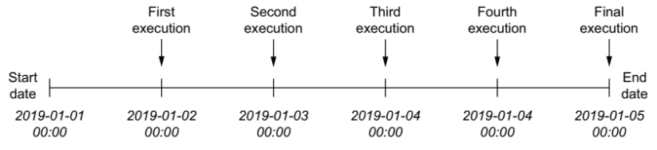
Scheduling intervals
Schedule intervals for a daily scheduled DAG with specified
Start (2019-01-01) and
End dates (2019-01-05)

Slide 33
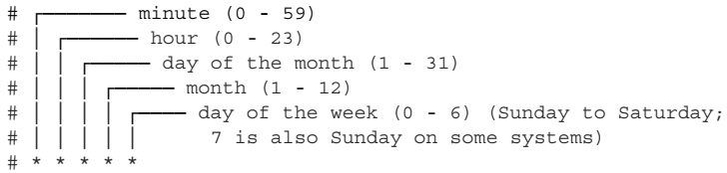
Cron-based intervals
Examples:
0 * * * * = hourly (running on the hour)
0 0 * * * = daily (running at midnight)
0 0 * * 0 = weekly (running at midnight on Sunday)
More complicated examples:
0 0 1 * * = midnight on the first of every month
45 23 * * SAT = 23:45 every Saturday

Slide 34
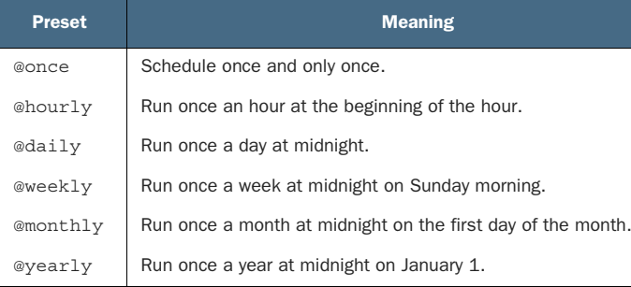
Airflow presets for frequently

Slide 35
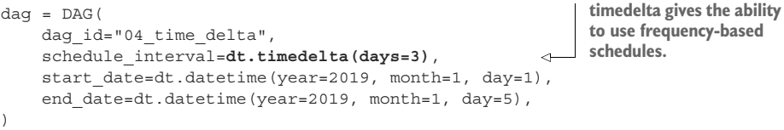
Frequency-based intervals
Run every three days following the start date (on the 4th, 7th, 10th, and so on of January 2019).

Slide 36
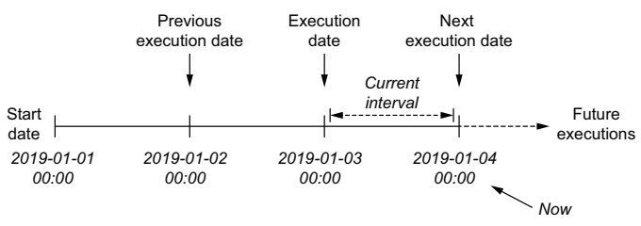
Execution dates in Airflow

Slide 37
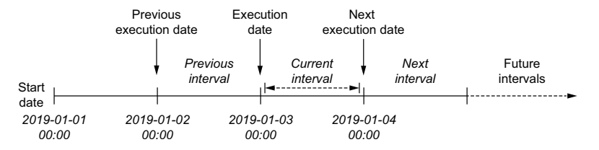
Execution date
Defined as start time of corresponding schedule interval rather than time at which the DAG is executed (which is typically the end of the interval)
As such, value of execution_date points to start of the current interval, while the previous_execution_date and next_execution_date parameters point to start of previous and next schedule intervals, respectively
Current interval can be derived from a combination of the execution_date and the next_execution_date, which signifies the start of the next interval and thus the end of the current one.

Slide 38
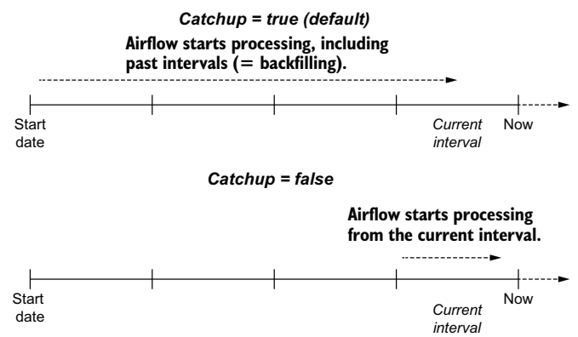
Backfilling

Slide 39
Best practices for designing tasks
Atomicity
Either all occur or nothing occurs
Idempotency
Rerunning a task without changing the inputs should not change the overall output

Slide 40

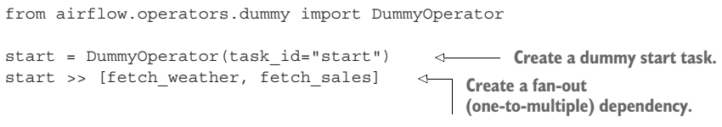
Defining dependencies between tasks

Slide 41
Thanks

